Slide 1
What is Data Warehouse?
A data warehouse is a type of data management system that is designed to enable and support business intelligence (BI) activities, especially analytics.
A data warehouse architecture is a method of defining the overall architecture of data communication processing and presentation that exist for end-clients computing within the enterprise.

Slide 2
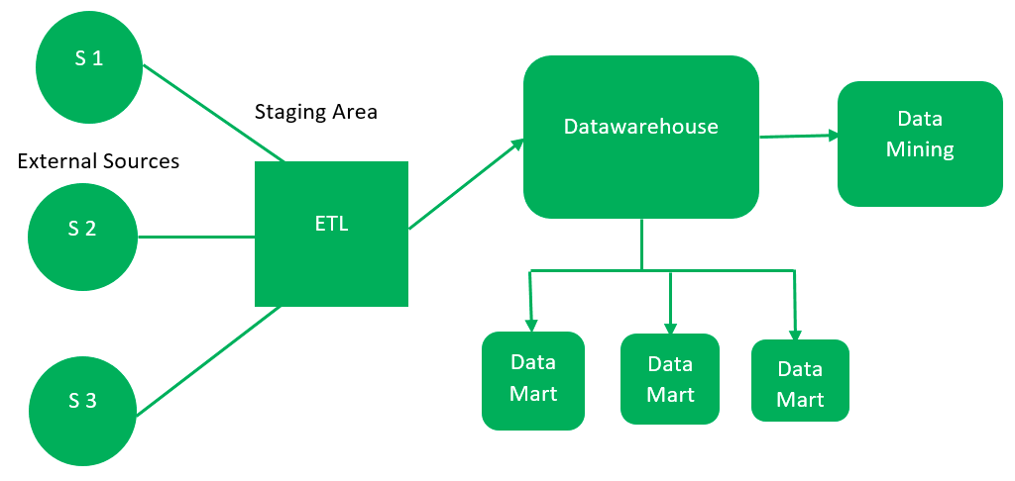
There are 2 approaches for constructing data-warehouse: Top-down approach and Bottom-up approach
Top-down approach

Slide 3
External Sources – External source is a source from where data is collected irrespective of the type of data. Data can be structured, semi structured and unstructured as well.
Stage Area – Since the data, extracted from the external sources does not follow a particular format, so there is a need to validate this data to load into datawarehouse. For this purpose, it is recommended to use ETL tool.
Data-warehouse – After cleansing of data, it is stored in the datawarehouse as central repository. It actually stores the meta data and the actual data gets stored in the data marts. Note that datawarehouse stores the data in its purest form in this top-down approach.
Data Marts – Data mart is also a part of storage component. It stores the information of a particular function of an organisation which is handled by single authority. There can be as many number of data marts in an organisation depending upon the functions. We can also say that data mart contains subset of the data stored in datawarehouse.
Data Mining – The practice of analysing the big data present in datawarehouse is data mining. It is used to find the hidden patterns that are present in the database or in datawarehouse with the help of algorithm of data mining.

Slide 4
Advantages of Top-Down Approach –
Since the data marts are created from the datawarehouse, provides consistent dimensional view of data marts.
Also, this model is considered as the strongest model for business changes. That’s why, big organisations prefer to follow this approach.
Creating data mart from datawarehouse is easy.
Disadvantages of Top-Down Approach –
The cost, time taken in designing and its maintenance is very high.
This approach is defined by Inmon as – datawarehouse as a central repository for the complete organisation and data marts are created from it after the complete datawarehouse has been created.

Slide 5
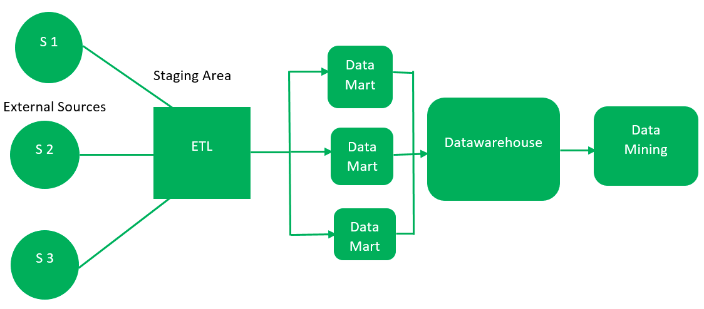
Bottom Up approach

Slide 6
First, the data is extracted from external sources (same as happens in top-down approach).
Then, the data go through the staging area (as explained above) and loaded into data marts instead of datawarehouse.
The data marts are created first and provide reporting capability. It addresses a single business area.
These data marts are then integrated into datawarehouse.
This approach is given by Kinball as – data marts are created first and provides a thin view for analyses and datawarehouse is created after complete data marts have been created.

Slide 7
Advantages of Bottom-Up Approach –
As the data marts are created first, so the reports are quickly generated.
We can accommodate more number of data marts here and in this way datawarehouse can be extended.
Also, the cost and time taken in designing this model is low comparatively.
Disadvantage of Bottom-Up Approach –
This model is not strong as top-down approach as dimensional view of data marts is not consistent as it is in above approach.

Slide 8
Three-Tier Data Warehouse Architecture
This is the most widely used Architecture of Data Warehouse.
It consists of the Top, Middle and Bottom Tier.
Bottom Tier: The database of the Datawarehouse servers as the bottom tier. It is usually a relational database system. Data is cleansed, transformed, and loaded into this layer using back-end tools.
Middle Tier: The middle tier in Data warehouse is an OLAP server which is implemented using either ROLAP or MOLAP model. For a user, this application tier presents an abstracted view of the database. This layer also acts as a mediator between the end-user and the database.
Top-Tier: The top tier is a front-end client layer. Top tier is the tools and API that you connect and get data out from the data warehouse. It could be Query tools, reporting tools, managed query tools, Analysis tools and Data mining tools.

Slide 9
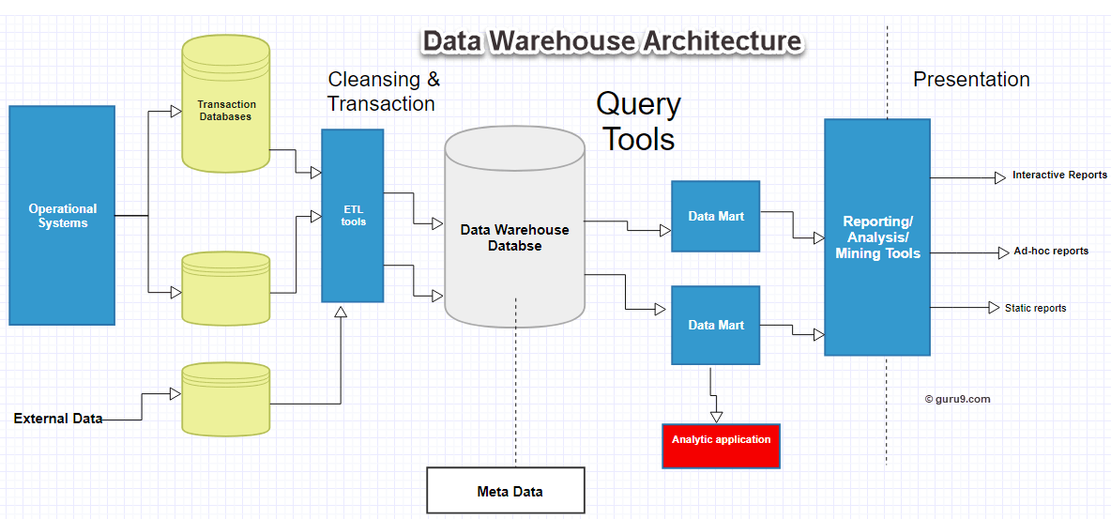


Slide 10
What is Lambda architecture ?
Lambda architecture is a data-processing architecture designed to handle massive quantities of data by taking advantage of both batch and stream-processing methods.
This approach to architecture attempts to balance latency, throughput, and fault-tolerance by using batch processing to provide comprehensive and accurate views of batch data, while simultaneously using real-time stream processing to provide views of online data. The two view outputs may be joined before presentation. The rise of lambda architecture is correlated with the growth of big data, real-time analytics,

Slide 11
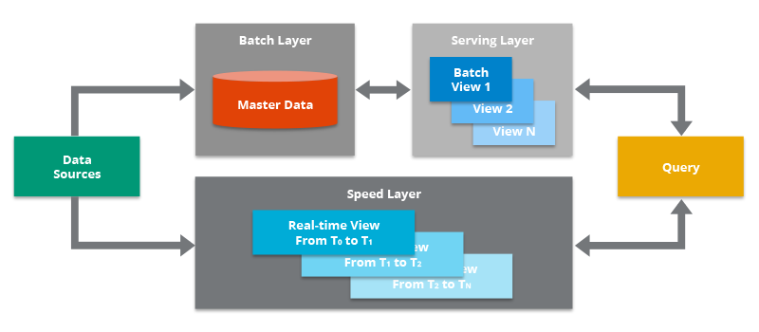
The Lambda Architecture contains both a traditional batch data pipeline and a fast streaming pipeline for real-time data, as well as a serving layer for responding to queries.

Slide 12
The batch layer precomputes results using a distributed processing system that can handle very large quantities of data. The batch layer aims at perfect accuracy by being able to process all available data when generating views. This means it can fix any errors by recomputing based on the complete data set, then updating existing views. Output is typically stored in a read-only database, with updates completely replacing existing precomputed views.
The speed layer processes data streams in real time and without the requirements of fix-ups or completeness. This layer sacrifices throughput as it aims to minimize latency by providing real-time views into the most recent data. Essentially, the speed layer is responsible for filling the "gap" caused by the batch layer's lag in providing views based on the most recent data. This layer's views may not be as accurate or complete as the ones eventually produced by the batch layer, but they are available almost immediately after data is received, and can be replaced when the batch layer's views for the same data become available.
Output from the batch and speed layers are stored in the serving layer, which responds to ad-hoc queries by returning precomputed views or building views from the processed data.

Slide 13
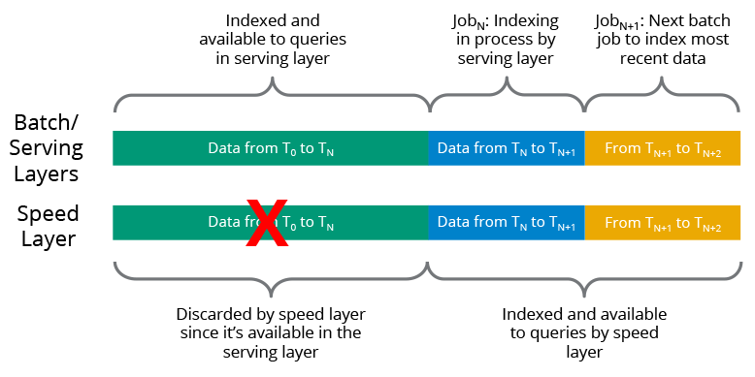
How Does the Lambda Architecture Work?
The batch/serving layers continue to index incoming data in batches. Since the batch indexing takes time, the speed layer complements the batch/serving layers by indexing all the new, unindexed data in near real-time. This gives you a large and consistent view of data in the batch/serving layers that can be recreated at any time, along with a smaller index that contains the most recent data.
Data is indexed simultaneously by both the serving layer and the speed layer.

Slide 14
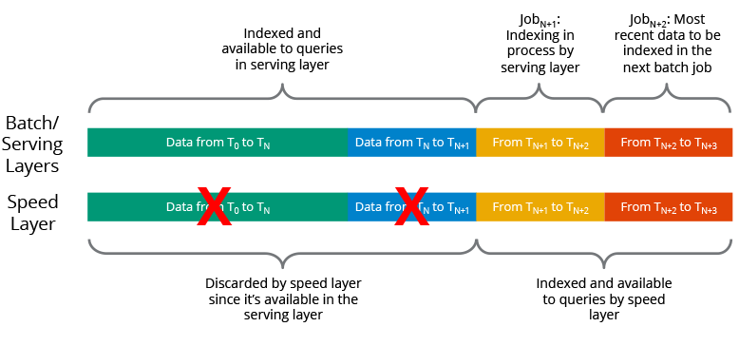
Once a batch indexing job completes, the newly batch-indexed data is available for querying, so the speed layer’s copy of the same data/indexes is no longer needed and is therefore deleted from the speed layer. The serving layer then begins indexing the latest data in the system that had not yet been indexed by this layer, which has already been indexed by the speed layer (so it is available for querying at the speed layer). This ongoing hand-off between the speed layer and the batch/serving layers ensures that all data is ready for querying and that the latency for data availability is low.
When the serving layer completes a job, it moves to the next batch and the speed layer discards its copy of the data that the serving layer just indexed.

Slide 15
What Are the Benefits of the Lambda Architecture?
Latency. Raw data is indexed in the serving layer so that end users can query and analyze all historical data. Since batch indexing takes a bit of time, there tends to be a relatively large time window of data that is temporarily not available to end users for analysis. The speed layer uses stream processing technologies to immediately index recent data that is currently not queryable in the batch/serving layers, thus narrowing the time window of unanalyzable data. This helps to reduce the latency (i.e., the wait time for making data available for analysis) that is inherent in the batch/serving layers.
Data consistency. One key idea behind the Lambda Architecture is that it eliminates the risk of data inconsistency that is often seen in distributed systems. In a distributed database where data might not be delivered to all replicas due to node or network failures, there is a chance for inconsistent data. In other words, one copy of the data might reflect the up-to-date value, but another copy might still have the previous value. In the Lambda Architecture, since the data is processed sequentially (and not in parallel with overlap, which may be the case for operations on a distributed database), the indexing process can ensure the data reflects the latest state in both the batch and speed layers.

Slide 16
Scalability. The Lambda Architecture does not specify the exact technologies to use, but is based on distributed, scale-out technologies that can be expanded by simply adding more nodes. This can be done at the data source, in the batch layer, in the serving layer, and in the speed layer. This lets you use the Lambda Architecture no matter how much data you need to process.
Fault tolerance. As above, the Lambda Architecture is based on distributed systems that support fault tolerance, so should a hardware failure occur, other nodes are available to continue the workload. In addition, since all data is stored in the batch layer, any failures during indexing either in the serving layer or the speed layer can be overcome by simply rerunning the indexing job at the batch/serving layers, and letting the speed layer continue indexing the most recent data.

Slide 17
What is Data Lake | Delta Lake ?
A data lake stores large volumes of structured, semi-structured, and unstructured data in its native format. Data lake architecture has evolved in recent years to better meet the demands of increasingly data-driven enterprises as data volumes continue to rise.
What is a Delta Lake?
Delta Lake is an open source storage layer that brings reliability and performance to your data lakes. Delta Lake provides ACID transactions, scalable metadata handling, and unifies streaming and batch data processing. Delta Lake runs on top of your existing data lake and is fully compatible with Apache Spark APIs.

Slide 18
ACID stands for Atomicity, Consistency, Isolation, and Durability.
Remember whenever we have to check whether a Database is RDBMS or not, we used to check whether it ACID compliant or not.
Atomicity: A transaction is a single unit of operation. Transaction must exhibit an “all or nothing” behavior. There cannot be partial execution.
Consistency: Once the transaction is executed, it should move from one consistent state to another. All data should be valid according to all defined rules, including any constraints.
Isolation: Transaction should be executed in isolation from other transactions. No transaction will be affected by any other transaction. So a transaction cannot read data from any other transaction that has not yet completed.
Durability: · once a transaction is committed, it will remain in the system – even if there’s a system crash immediately following the transaction.

Slide 19
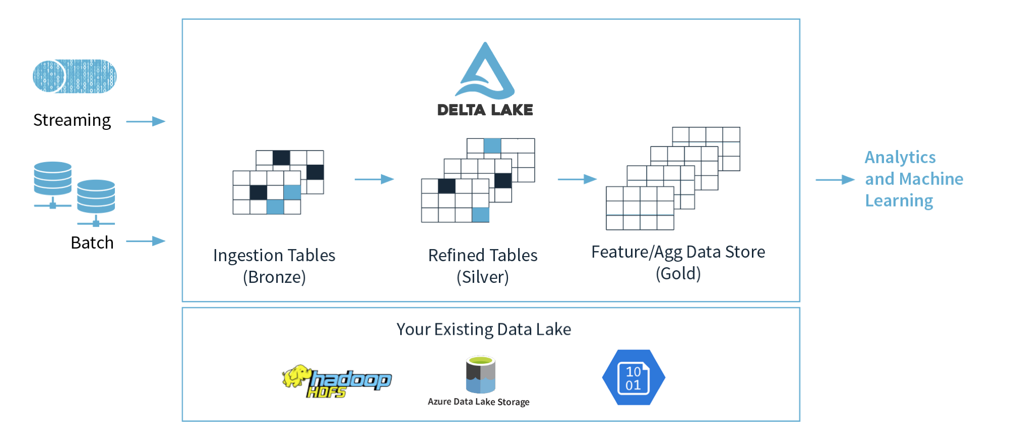
An example of a Delta Lake Architecture might be as shown in the diagram above.
Many devices generate data across different ingestion paths.
Streaming data can be ingested from IOT Hub or Event Hub.
Batch data can be ingested by Azure Data Factory or Azure Databricks.
Extracted, Transformed data is loaded into a Delta Lake.

Slide 20
Delta Lake architecture
The Delta Lake Architecture is a vast improvement upon the traditional Lambda architecture. At each stage, we enrich our data through a unified pipeline that allows us to combine batch and streaming workflows through a shared filestore with ACID-compliant transactions.
Bronze tables contain raw data ingested from various sources (JSON files, RDBMS data, IoT data, etc.).
Silver tables will provide a more refined view of our data. We can join fields from various bronze tables to enrich streaming records, or update account statuses based on recent activity.
Gold tables provide business level aggregates often used for reporting and dashboarding. This would include aggregations such as daily active website users, weekly sales per store, or gross revenue per quarter by department.
The end outputs are actionable insights, dashboards, and reports of business metrics.

Slide 21
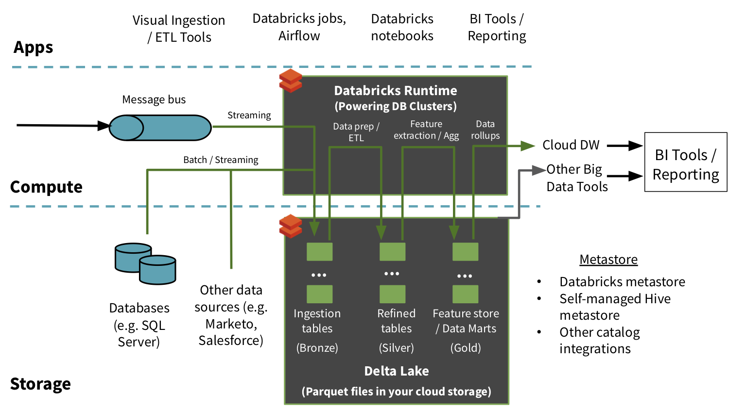

Slide 22
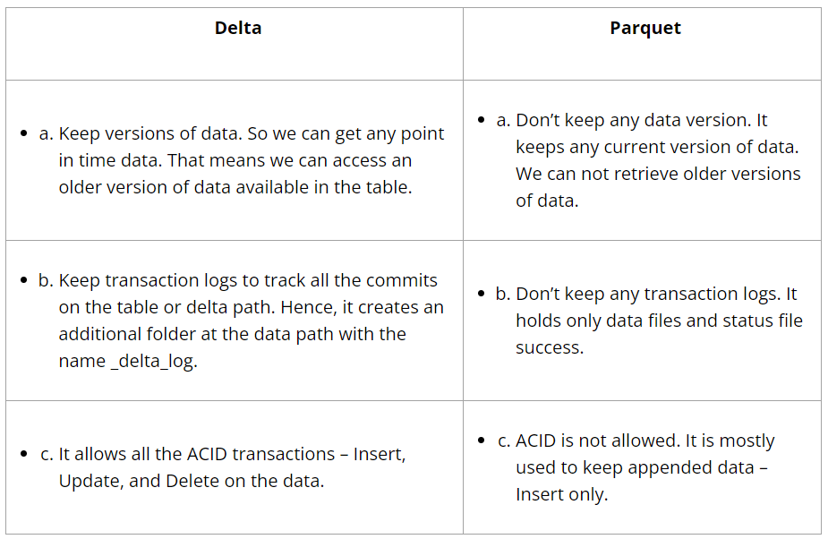
Delta vs Parquet in Databricks

Slide 23
Choose Between Delta vs Parquet
We have understood the differences between Delta and Parquet. We are now at the point where we need to choose between these formats. You have to decide based on your needs.
There are several reasons why Delta is preferable:
Many Insert, Delete transactions happened on data
Update required for your data
Want to keep versions of data
It is preferable to use parquet in the following situations:
There is only new data being appended
Updates are not required
Although the Delta has many features, it requires a little additional maintenance. Since it keeps versions, it is necessary to clean up the old data version periodically to improve performance. Further, if you are integrating this data with any other data system that is not compatible with delta format, then you will need to convert and use an additional layer.

Slide 24
Delta Lake Concurrency Control
if i ask you that how we used to handle concurrent transaction in RDBMS then your answer would be LOCK. By applying Shared/exclusive locks.
Now think about delta lake. If there is no Lock feature, then how it is managing concurrent transactions.
Delta Lake uses optimistic concurrency control to provide transactional guarantees between writes.
Suppose user A and user B is making changes on same table at same time. optimistic concurrency control guarantee that both transactions should complete successfully.
Now as we said above if there is no lock then how it’s possible?

Slide 25
To understand this let’s see how operations (Insert/Update/Delete/Alter) work on delta table.
Delta Lake transaction writes operate in four stages:
Record: Record the starting table version.
Read: Reads (if needed, in case of new record insert it’s not needed) the latest available version of the table to identify which files need to be modified (that is, rewritten).
As files are immutable and can’t be modified. So, it read the file in memory and modify the data (in case of update) and rewrite into new file.
Write: Stages all the changes by writing new data files.
Validate and commit: Before committing the changes, checks whether the proposed changes conflict with any other changes that may have been concurrently committed since the snapshot that was read. If there are no conflicts, all the staged changes are committed as a new versioned snapshot, and the write operation succeeds.
However, if there are conflicts, the write operation fails with a concurrent modification exception rather than corrupting the table as would happen with the write operation on a Parquet table.

Slide 26
Let’s understand how delta lake resolve any conflict.
Case 1 – let’s support there is an employee table, partitioned by state. User A (Transaction A) and User B (Transaction B) is trying to write data in same partition, let’s take state=FL.
Now let’s follow above steps.
1. Record: It will record current table version of table, let’s take version=2. You can get current table version.
%sql
DESCRIBE HISTORY employee_delta_table LIMIT 1
2. Read: As here User A and B trying to write new record into table, there is no need to read existing data.
3. Write: User A and B will write data to table in partition state=FL. It will create two ***.snappy.parquet files, one for each transaction.
4. Commit: now here is conflict. As there can be only one commit after recorded table version. So here Delta Lake handles this conflict with the concept of “mutual exclusion” one transaction will be accepted and other will rejected. Let say in this mutual exclusion user A won and user B lose.
But instead of throwing error to user B, Delta Lake prefers to handle this conflict optimistically. updates the table silently for those changes done by user A and then retries. It commits newly updated data and creating new table version. Here it will create version 4 instead of 3 (that’s taken by user A)

Slide 27
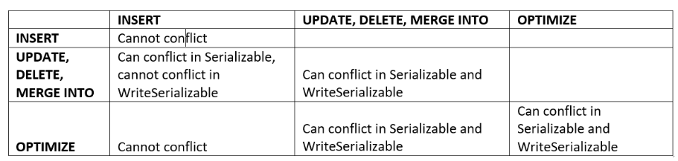
But it doesn’t mean delta lake can resolve all conflict and don’t throw any error. there are few problems that can’t be solved optimistically.
B
A
To avoid conflict partitioning of table play very crucial role.

Slide 28
Conflict exceptions
When a transaction conflict occurs, you will observe one of the following exceptions:
ConcurrentAppendException
ConcurrentDeleteReadException
ConcurrentDeleteDeleteException
MetadataChangedException
ConcurrentTransactionException
ProtocolChangedException

Slide 29
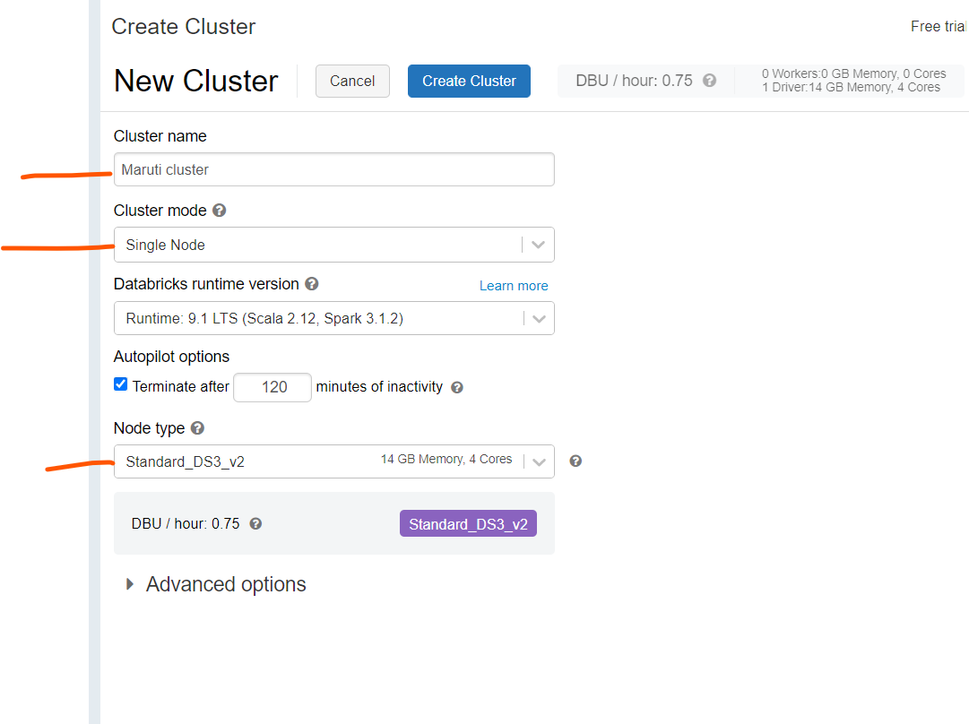

Slide 30

Azure Synapse Analytics
Limitless analytics service with unmatched time to insight
Artificial Intelligence / Machine Learning / Internet of Things
Intelligent Apps / Business Intelligence
Designed for analytics workloads at any scale
Synapse Analytics
SaaS developer experiences for code free and code first
Experience
Synapse Analytics Studio
Platform
Multiple languages suited to different analytics workloads
MANAGEMENT
Languages
MANAGEMENT
SQL
Python
.NET
Java
Scala
CLI
Integrated analytics runtimes available as a dedicated and serverless offering
SQL pools offering T-SQL for batch, streaming and interactive processing
Spark pools for big data processing with Python, Scala, R and .NET
SECURITY
Form Factors
SECURITY
DEDICATED
SERVERLESS
MONITORING
Analytics Runtimes
MONITORING
SQL
METASTORE
METASTORE
DATA INTEGRATION
Integrated platform services for, management, security, monitoring, and metastore
Azure
Data Lake Storage
Common Data Model
Enterprise Security
Optimized for Analytics
Data lake integrated and Common Data Model aware
Notes:
Talking points
Azure Synapse is a limitless analytics service that brings together enterprise data warehousing and Big Data analytics. It gives you the freedom to query data on your terms, using either serverless or provisioned resources—at scale. Azure Synapse brings these two worlds together with a unified experience to ingest, prepare, manage, and serve data for immediate BI and machine learning needs.
To derive real value from your data, you require a comprehensive platform with familiar tools and a robust ecosystem of partners and ISVS to deliver the solutions you need at cloud scale
One place for all your data: This is one of the most significant pain points we hear from customers. How can I get access to all of the data internally and externally to my organization. Each system needs its own database, that is true. Microsoft’s analytics solution is able to connect to those data sources and bring that data into a cloud scale data warehouse solution for deriving insights, from a variety of data sources.
Unlimited data scale: Not only can Microsoft’s solution process these diverse types of data, it can do it at scale, without constraints typically associated with existing on premises solutions.
Familiar tools and ecosystem: And, you don’t have to hire a number of specialists to manage a niche tool. Microsoft’s offerings provide familiar tools and ecosystem to help you leverage your investment quickly.
Lower TCO: The benefits noted all accrue to a lower TCO.
There’s a range of analytical scenario’s that Azure Synapse Analytics can address
Descriptive Analytics
The world of analytics, is evolving from the typical “Descriptive Analytics”, which is all about – What is happening in my business?
Diagnostic Analytics
The data insights, provided by descriptive analytics, are needed to provide the answer to: , “Why it is happening in your business”, which is often referred to analyzing root cause, or “Diagnostic Analytics”. Both, Descriptive and Diagnostic Analytics, is seen as a workload which is primarily providing a reactive response --- from what is happening, why is it happening, to what I am I going to do about it?
Predictive Analytics
By building out predictive patterns on top of your data, by utilizing the data findings from Descriptive, Diagnostic and Predictive data, you’ll be able to identify what is based on what you get from descriptive and diagnostic analytics and used to find answers to the question of what is likely to happen in the future based on previous trends and patterns?
Prescriptive Analytics
Techniques used to provide a predictive insights into your data, is commonly introduced by building out machine learning models, to “predict” trends and give the answer to the very. When you get the findings from Descriptive, Diagnostic and Predictive analytics like what’s happened, the root cause behind that and what-might-happen in future, Prescriptive model utilizes those answers to help you determine the best course of action to choose to bypass or eliminate future issues.
Source: https://www.weirdgeek.com/2018/11/types-of-analytics/
Across all organizations and industries, common use cases are identified by the need for:
Modern data warehousing: The ability to integrate all data, including big data, with the ability to reason over data for analytics and reporting purposes, and reason over data, independent of its location or structure.
Advanced Analytics – go beyond the area of reporting, and driving analysis and turn your wealth of data into the ability to “predict what happens next”.
Real time Analytics –capture, store and analyze data in real-time or near-real time
Instructor notes and guidance
In short Azure Synapse Analytics is the one stop shop to meet all of your analytical needs in an integrated environment. The notes in the slide are for reference only should you share the slide deck. You don't need to go through them
Recommended reading for this slide
https://docs.microsoft.com/en-us/learn/modules/introduction-azure-synapse-analytics/

Slide 31
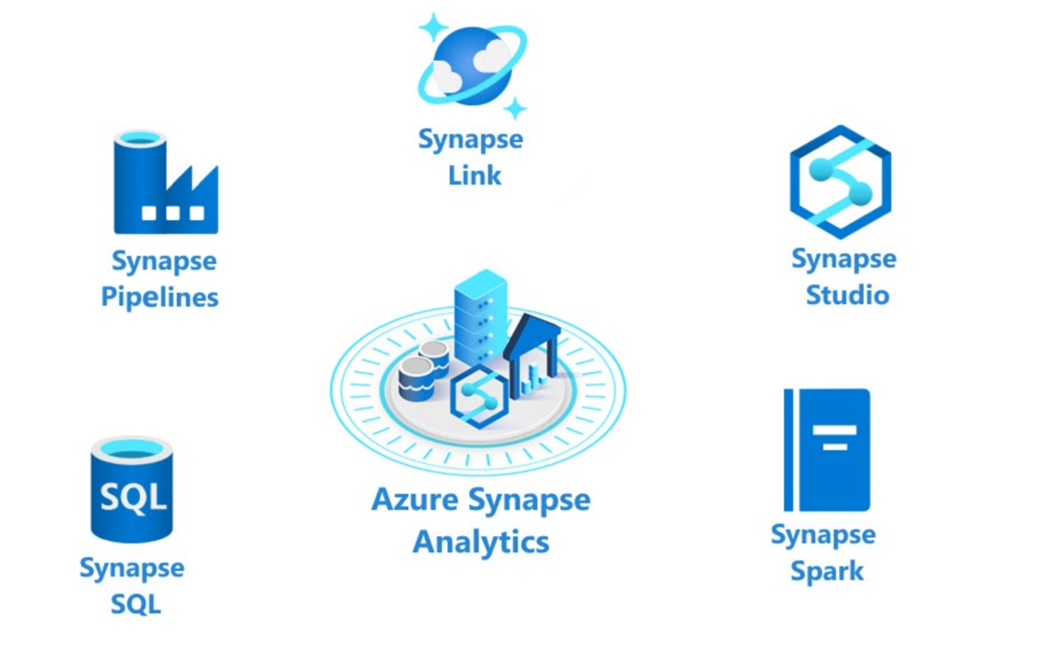
Introduction to Azure Synapse Analytics
Notes:
Talking points
The following components are available in Azure Synapse Analytics:
- Analytics capabilities are offered through Synapse SQL through either dedicated SQL pools or serverless SQL pools.
- Apache Spark pool with full support for Scala, Python, SparkSQL, and C# with Synapse Spark
- Data Integration & Orchestration to integrate your data and operationalize all of your code development with Synapse Pipelines
- Perform operational analytics with near real-time hybrid transactional and analytical processing with Azure Synapse Link.
- Use Synapse Studio to access all of these capabilities through a single Web UI
Instructor notes and guidance
Only provide the headlines of the capability on this slide, tell the students that coverage of Azure Synapse Analytics is provided in the following modules
Module 2: Run interactive queries using serverless SQL pools
Module 4: Explore, transform, and load data into the data warehouse using Azure Synapse Analytics Apache Spark
Module 5: Ingest and load Data into the Data Warehouse
Module 6: Transform Data with Azure Data Factory or Azure Synapse Pipelines
Module 7: Integrate Data from Notebooks with Azure Data Factory or Azure Synapse Pipelines
Module 8: End-to-end security with Azure Synapse Analytics
Module 9: Support Hybrid Transactional Analytical Processing (HTAP) with Azure Synapse Link
Call out to the students, that in the lab for this module, they will experience working with Apache Spark pools in Azure Synapse Analytics and how it works with a data lake, this is only one aspect of Azure Synapse analytics, and they will cover more in later modules
Recommended reading for this slide
https://docs.microsoft.com/en-us/learn/modules/survey-components-of-azure-synapse-analytics/

Slide 33
https://docs.microsoft.com/en-us/learn/modules/describe-azure-databricks-delta-lake-architecture/3-perform-batch-stream-processing

Slide 34
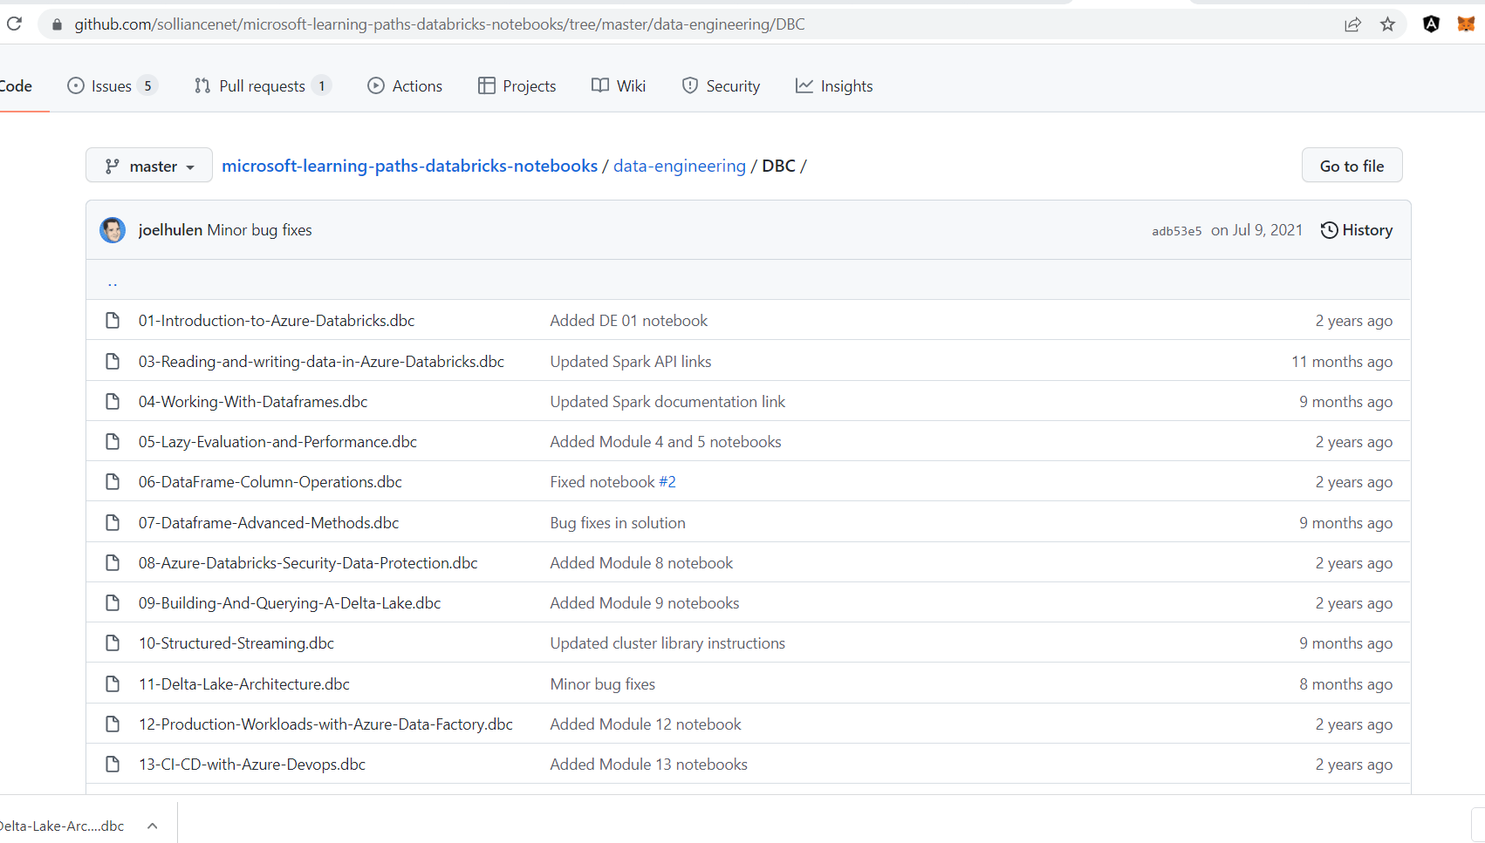

Slide 35
If you are working on Data warehouse project, than you might have heard lot about surrogate keys. Surrogate keys are widely accepted data warehouse design standard.
Data warehouse surrogate keys are sequentially generated meaningless numbers associated with each and every record in the data warehouse. These surrogate keys are used to join dimension and fact tables.
Usually, database sequences are used to generate surrogate key so it is always unique number
Surrogate keys cannot be NULLs. Surrogate key are never populated with NULL values.
It does not hold any meaning in data warehouse, often called meaningless numbers. It is just sequentially generated INTEGER number for better lookup and faster joins.

Slide 36
Basically, surrogate key is an artificial key that is used as a substitute for natural key (NK) defined in data warehouse tables. We can use natural key or business keys as a primary key for tables. However, it is not recommended because of following reasons:
Natural keys (NK) or Business keys are generally alphanumeric values that is not suitable for index as traversing become slower. For example, prod123, prod231 etc
Business keys are often reused after sometime. It will cause the problem as in data warehouse we maintain historic data as well as current data.
For example, product codes can be revised and reused after few years. It will become difficult to differentiate current products and historic products. To avoid such a situation, surrogate keys are used.

Slide 37
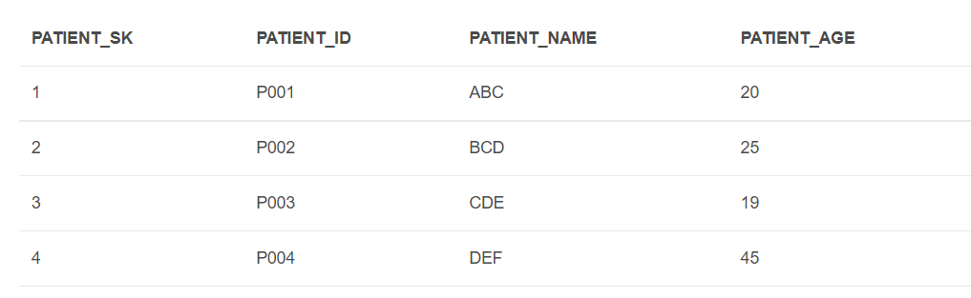
Surrogate Keys are integers that are assigned sequentially in the dimension table which can be used as primary key. The surrogate key column could be identity column or database sequences are used.
Below is the sample example of surrogate key:

Slide 38
